Slide 1


The Next
Government Workforce:
How Ready Are You?
Patrick Ibarra, The Mejorando Group

Slide 2
“Are you changing as fast as the world around us?
2
2

Slide 3
“What’s your Employer Value Proposition?
3
3

Slide 4
Why would a talented person want to join your organization and stay with us?
Why would a talented person be reluctant to join your organization and stay with us?
What does a talented employee need to learn to be considered for a promotion?
4
4

Slide 5
Future Factors…
Politics and Citizen Activism
Social Media
Legislation and Legal
Economic and Environmental
Government
VUCA
Technology and Service Delivery
Changing Employee Expectations
Shifting Demographics
5

Slide 6
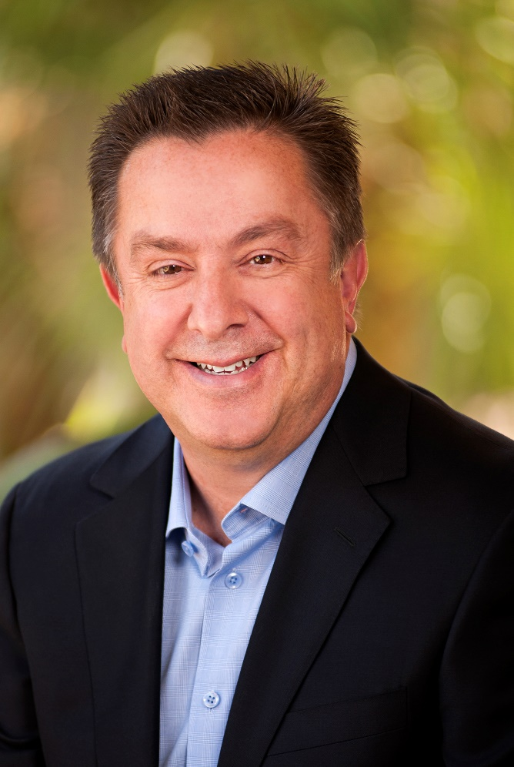




Today’s Presenter
Patrick Ibarra
Former City Manager
Founder of the Mejorando Group
(925)518-0187
patrick@gettingbetterallthetime.com

Slide 7
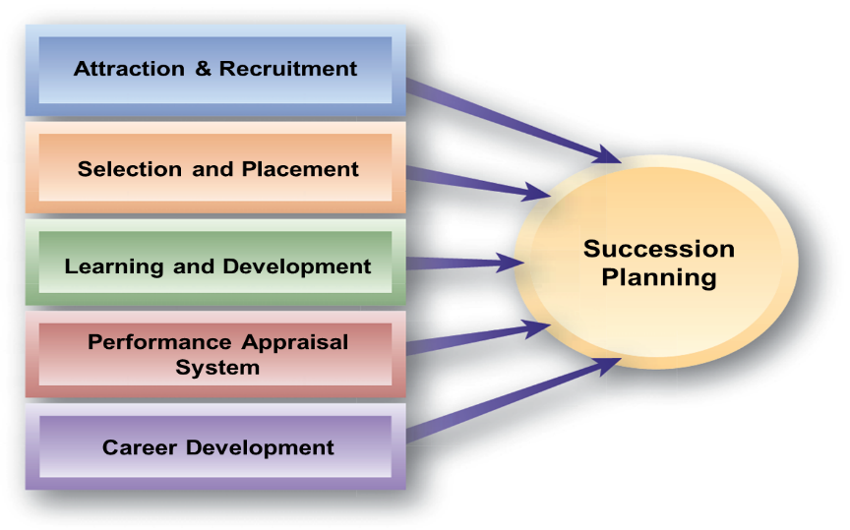
Values-Based
Principles Led
Successful
Purpose Driven
Performance Focused
Healthy Workplace Culture
7

Slide 8
Turn to your colleagues…
What will our organization need to be like to be highly successful in the future?
What will our citizens/customers require of us?
What will our employees require of us?

Slide 9
Every organization is perfectly designed to get the results it gets.
9
9

Slide 10
10

Slide 11
Do you want Commitment or Compliance?
11

Slide 12
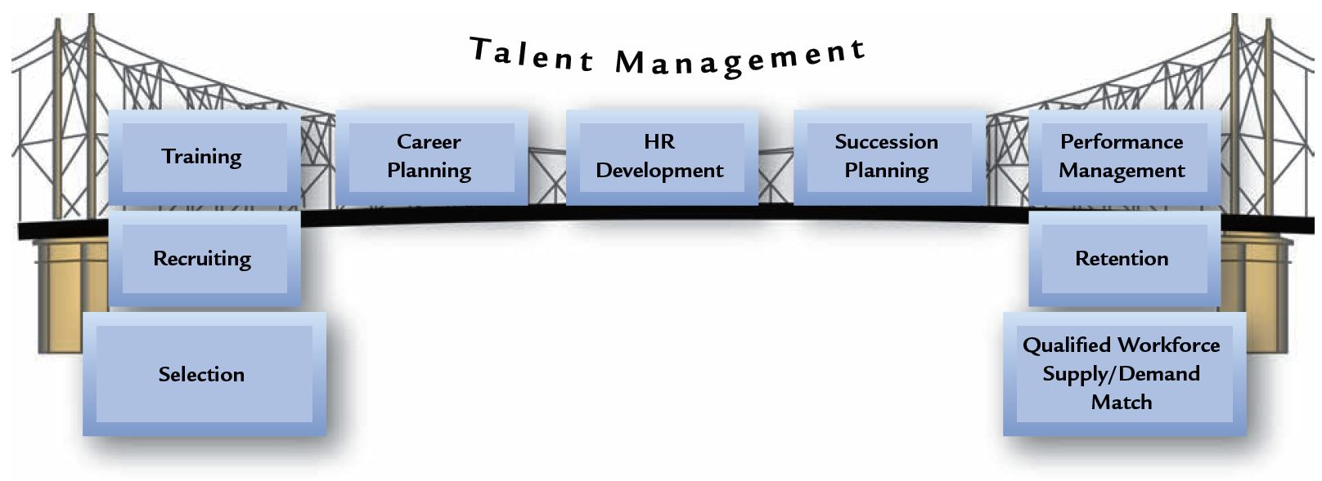
Career
Pathing
Learning/Training
Succession
Planning
Retention of High Performers
HR Policies
On-Boarding
Employee
Experience
Recruiting & Selection
Performance
Management
12

Slide 13
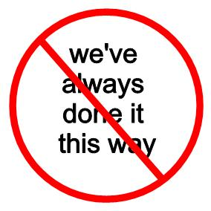

Slide 14
Strategy
What business
are you in?
14

Slide 15
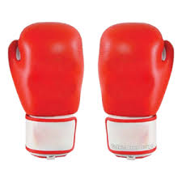
Cost
Value
15

Slide 16














Utility vs. Experience
16
16

Slide 17
Purpose: What Customers Want
Service
Quality
Promise: What
You Say You’ll Do
Performance: What You Actually Do
17
17

Slide 18
Chief
Experience
Officer
18

Slide 19
Healthy Culture
Employee Engagement
High
Performance

Slide 20
How do your employees feel about where they work?
20
20

Slide 21
Factors influencing Employee Performance
Workplace
Culture
Attitude
Mission, Vision
and Values
Individual skills
Workforce
Effectiveness
Reward
System
Performance
Management
Leadership &
Supervision
Job Design &
Work
Processes

Slide 22
Rocks  | Rock Solid  ? | Rock Stars 

Slide 23
Lather,
Rinse,
Repeat
23

Slide 24
“If we weren’t already doing it this way,
is this the way we would start?”
- Peter Drucker
24

Slide 25
Moon Shot
1
Wild Shot
2
Roof Shot
3

Slide 26
Instill a Talent Mindset
Differentiate & Affirm
Create a Winning Employee Value Proposition
Recruit Talent Continuously
Grow Leaders
26
26

Slide 27
What is Succession Planning
…ensures the continued effective performance of your organization by establishing a process to manage talent and build bench strength.”
27

Slide 28

Values and Benefits
Continuity of operations.
Having an adequate supply of employees to fill future key openings – i.e. a pool of talent
Providing career paths and plans for employees, which aids in employee retention and performance motivation
Continually reviewing the need for individuals as organizational changes occur
Enhancing the organizational “brand” and reputation as a desirable place to work
28

Slide 29
Across All Levels
Succession Planning
Technical
Professional
Executive
Managerial
29

Slide 30
Yesterday’s Ad
DEFINITION:
Participates in an intensive training program in basic fire fighting, emergency medical treatment, and peace officer responsibilities.
CLASSIFICATION STANDARDS:
Positions in this class are allocable only to the Fire Department. Incumbents participate in a basic emergency medical services and fire fighting training program involving both field and classroom instruction prior to appointment as a Fire Fighter. They must have the mental ability to assimilate classroom instructions and the physical skill, stamina, coordination to become proficient in all fire fighting and rescue techniques and the physical ability to provide quality care to people in need due to emergencies involving medical issues, fire suppression, and other emergency and non-emergency situations.
Essential Job Functions
•Under close supervision, participates in a fire fighting training course.
•Through classroom and field training, learns proper fire fighting techniques and procedures for fighting structural, watershed, chemical, petroleum, electrical and other fires.
•Receives instructions and participates in field training to learn proper procedures and acquire proficiency in the rescue or evacuation of persons endangered by fire or disaster in the provision of emergency medical care.

Slide 31
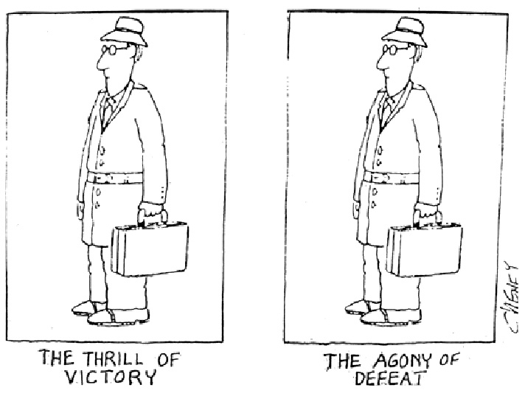
QuickTime™ and a
are needed to see this picture.

Slide 32
Adventurers
Wanted!
We help you realize your potential.
32

Slide 33
Recruitment Improvements
Establish a Recruitment Plan for each vacancy
Improve the recruitment message in job postings
Sourcing Strategy including use of social media channels
Create a Time-to-Hire metric
Canvas list of seasonal employees for potential future candidates applying for full-time positions.
33
33

Slide 34
Recruitment Improvements
Job Opportunities on web site and home page for all departments
New name for job openings – www.countynamejobs.com
Testimonials from current employees
Starting Salaries on job announcements
34
34

Slide 35
Leadership Model
Strategic
Skills
People
Skills
Catalyst for
Change
Achieving Results
Political Savvy
Initiative &
Drive
Culture
Advocate
35

Slide 36
Learning/Training Opportunities
Executives
Creative Problem Solving
Mid-Mgrs
Building Great Work Teams
Frontline
New Supervisor
Leading Change
Managing Employee Performance
Effective Delegation
Project Management
Providing Effective Feedback
Time Management

Slide 37
Employee Development Techniques
Job
Assignments
On-the-
Job
Coaching
Mentoring
Program
Special
Projects
“Acting”
Role
Job
Rotation
Conference
Leader
Shadowing
Task Force
Assignments

Slide 38
Young People Today…
Ability to Impact
Collaborative
Access
Engagement
Strategies
Visibility
Training & Development
Opportunity
Embrace
Change
38

Slide 39

Outcomes - Benefits
Synchronized Strategy
Talent Optimization
Service Delivery
Modern
Workforce
Strengthened Employer Brand
Leadership Bench
39

Slide 40
Growth and Comfort don’t
Co-exist

Slide 41
The future is run and won by those who are willing to think differently.

Slide 42
Pressure is a Privilege

Slide 43
The Mejorando Group
Who are we? A Change and Organizational Effectiveness Consulting Practice.
What do we do? Partner with organizations and implement solutions to improve organizational performance.
How do we do that? We provide expertise in:
  Succession Planning & Talent Management
  Organizational Effectiveness Services
  Strategic Planning Facilitation Services
  Leadership and Management Skills Training
How do you contact us? Patrick Ibarra, 925-518-0187 or patrick@gettingbetterallthetime.com
Web address: www.gettingbetterallthetime.com
Our mission is to help organizations and
their members “get better all the time”

