Slide 1
Healing the Healer: Building a culture of Health at work
Presented by Elias Diaz

Slide 2
Objectives
Discuss how organizational values can lay the foundation for a healthy work culture.
Discuss elements of a safe workspace.
Identify strategies for a healthier work environment.

Slide 3
Principles of Action (Plough)
1. We are all in this together.

Slide 4
Organizational Values
Who are you?
What do you stand for?
What wouldn’t you stand for?

Slide 5
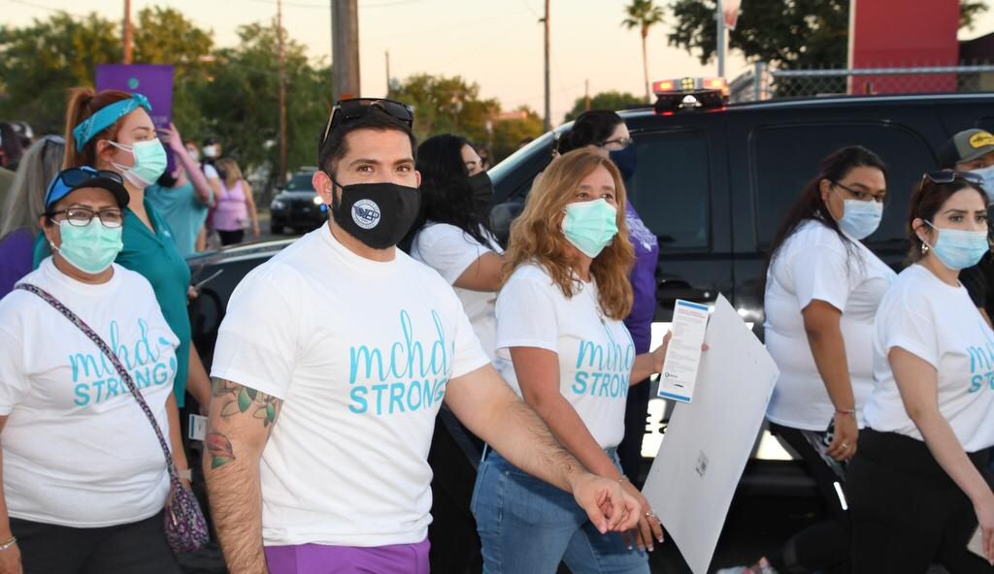
Is your organization’s statement unique to you?

Slide 6
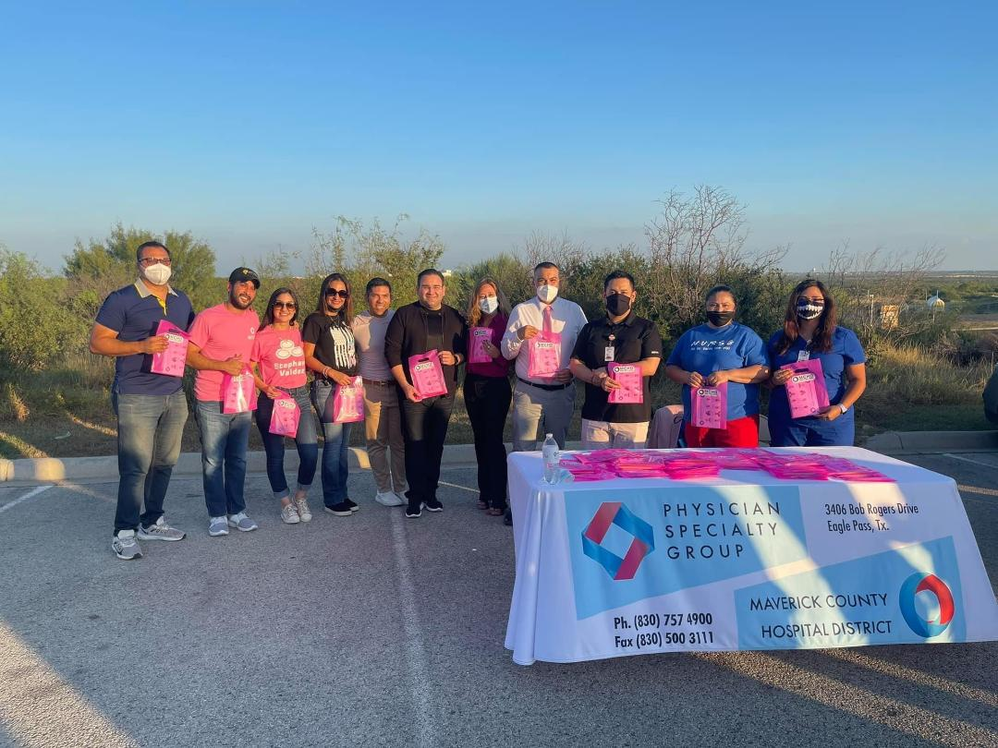
Does your statement inspire team members?

Slide 7
Principles of Action (Plough)
2. The health of the population guides decision making.

Slide 8
Principles of Action (Plough)
3. Individuals have the means and opportunities to make choices that lead to healthy lifestyles and well-being and optimal well-being and functioning.

Slide 9
Work Environment Stressors
Stressful events (acute)
Chronic stressors
Hassles
Role ambiguity
Role conflict
Role overload
Monotony
Psychological contract violations
Uncertainty (e.g., job insecurity)

Slide 10
Scene from The Devil Wears Prada

Slide 11
Consequences of an unhealthy work environment
Relationship damage
Dissatisfaction
Diminished performance
Less active use of leisure time
Depression
Burnout
Turnover
Worker’s compensation costs
Health claims
Presenteeism
Absenteeism
Diminished morale

Slide 12
Scene from Office Space

Slide 13
Environmental Moderators
Person-environment fit
Job control
Social support
Organizational climate
Organizational culture
Balance among objectives
Supervisor behavior

Slide 14
Clip from The Pursuit of Happyness

Slide 15
Personal Moderators
Health practices
Self-esteem
Organization-based self-esteem
Self-efficiency
Self-discrepancies
Hostility
Type A behavior pattern
Locus of control
Workaholism
Explanatory style
Rumination
Perfectionism

Slide 16
Principles of Action (Plough)
4. Healthcare is efficient and equitable.

Slide 17
Strategies for healthier work environment
Redesign
Stress audits
Health promotion
Action research
Time management
Stress management training
Ergonomics
Employee assistance plans
Person-environment matching
Work environment monitoring
Monitoring supervisor behavior
Leadership development

Slide 18
Thank you
Email: e.diaz@mchdep.org
Telephone: (830)757-4946

